Slide 1
Online bug detection engine for java programs
徐昊，季尚松，胡超

Slide 2

Problem
Difficult to handle Java code well.
Bad habit can lead to Hazard.
Need to download the whole debug tool.
Difficult to config debug tool.

Slide 3
Solution
Build a online debug website
Package the Interface between user and tool.
Easily config the tool by GUI.
Provide different ways fot debuging.
Track the debug log for further study.
Search and read bug information.

Slide 4
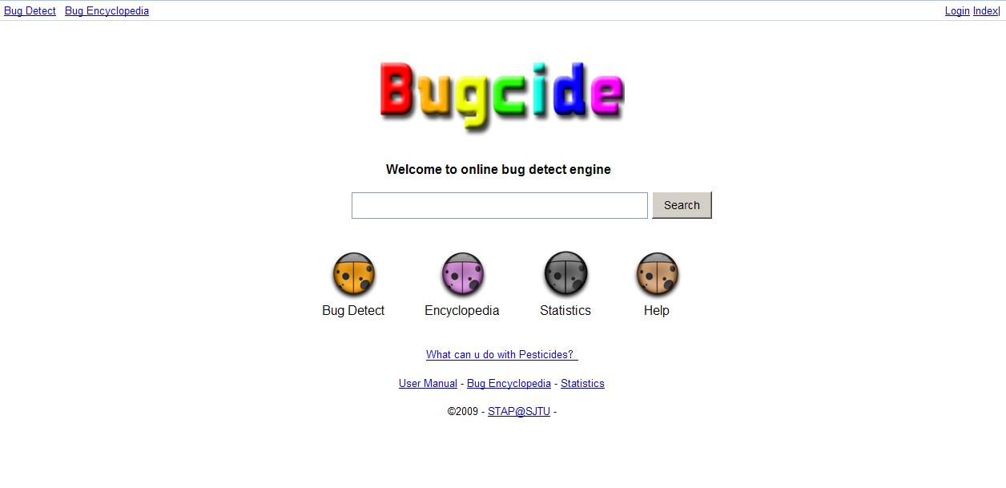
Here comes Bugcide!

Slide 5
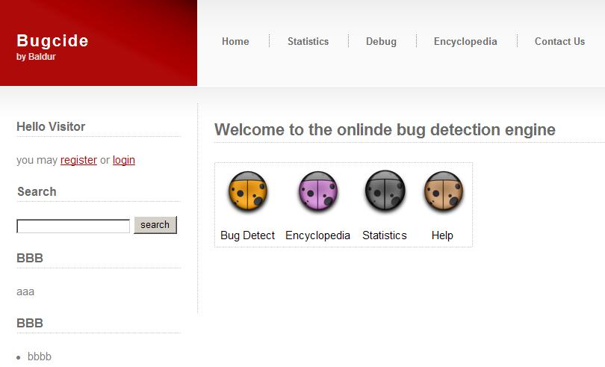

Slide 6


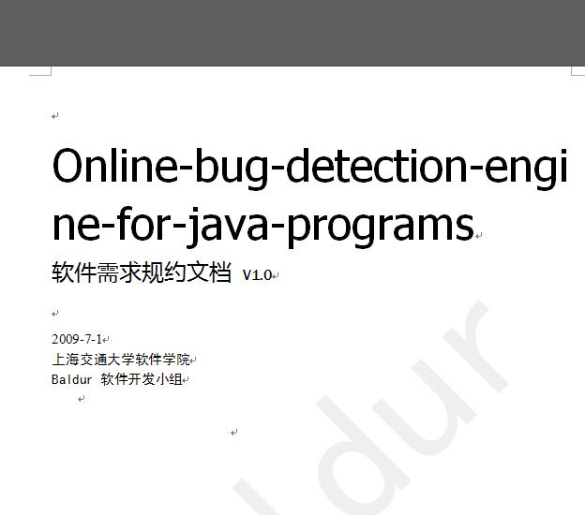
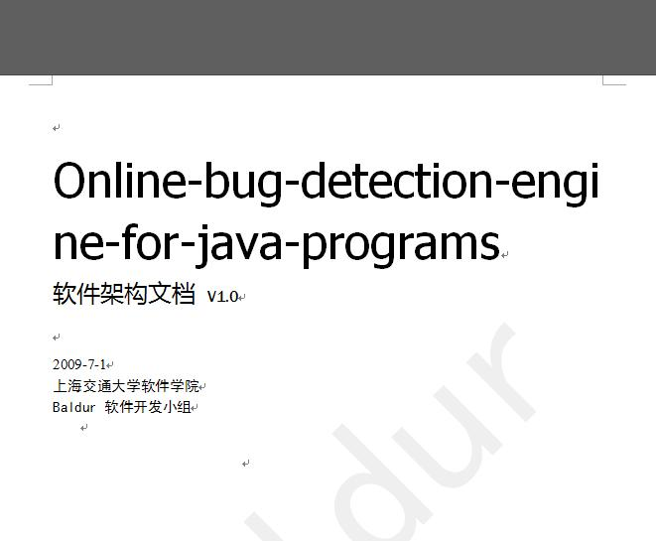

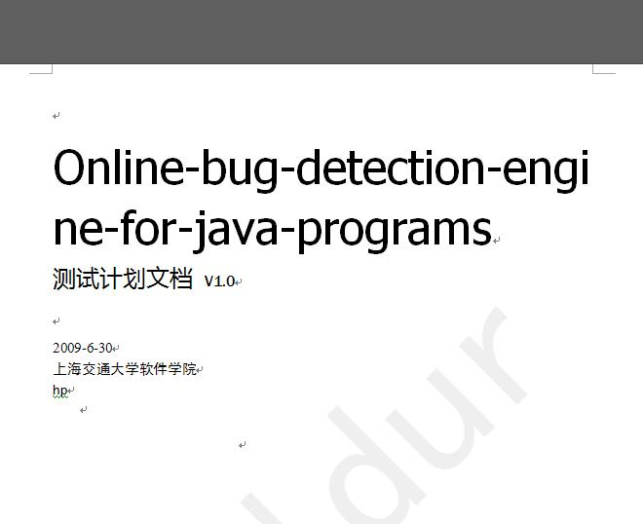
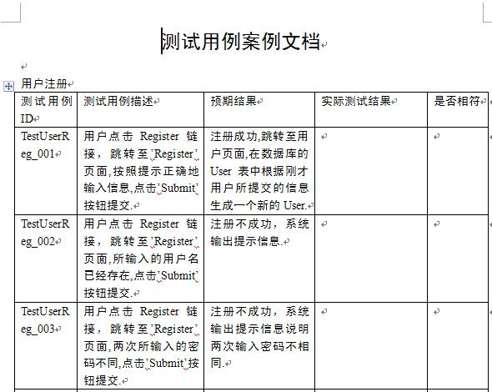

Slide 7
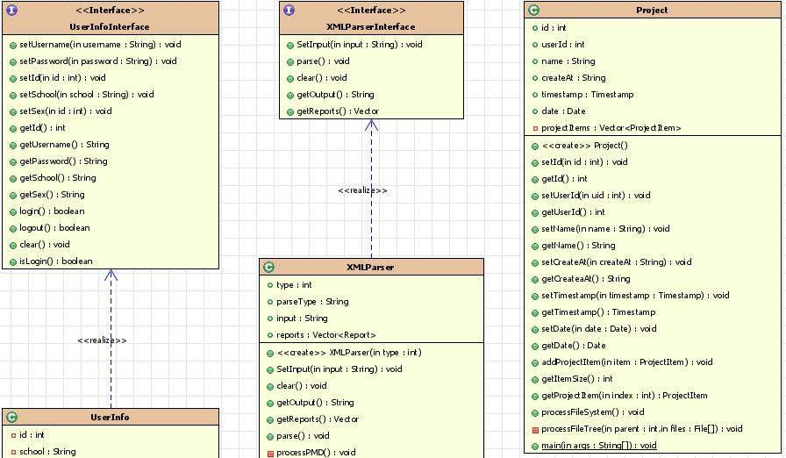

Slide 8
Function Point
Users can have their own account.
Different ways and styles to debug.
No command line. All GUI.
Collect all debug statistics.
Bug Information for reference.

Slide 9
Show Time

Slide 10
Q&A

Slide 11
Thanks

